Slide 1
Support Vector Machines
Hyperplane based Classification:

Slide 2
Introduction
Classification as a Hyperplane locations Problem
Motivation for Linear support Vectors
SVM as Quadratic Optimization Problem
Non Linear SVM
Kernel Functions

Slide 3
Build
Train
Test
Validation
Tuning

Slide 4
Supervised Machine Learning.

Slide 5
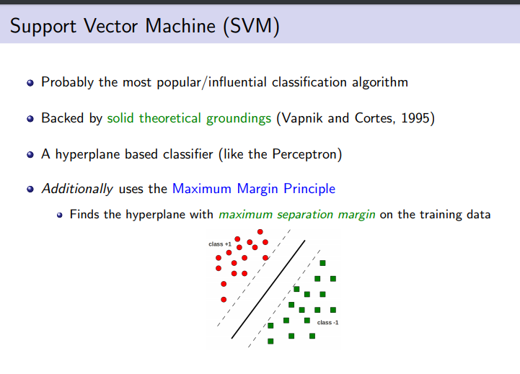

Slide 6
A Support Vector Machine (SVM) is a discriminative classifier
formally defined by a separating hyperplane. In other words, given labeled training data (supervised learning),
the algorithm outputs an optimal hyperplane which categorizes.

Slide 7
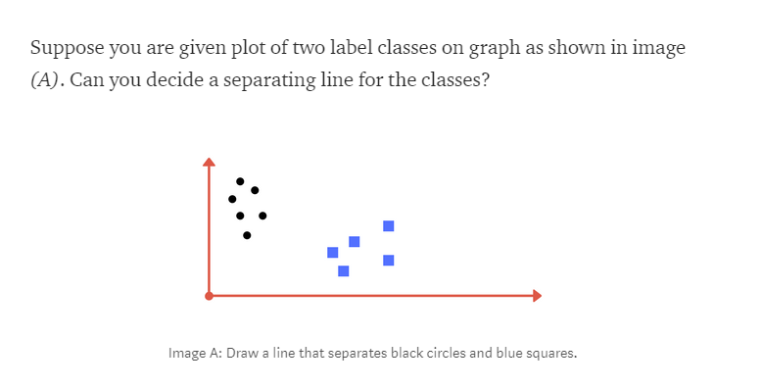

Slide 8
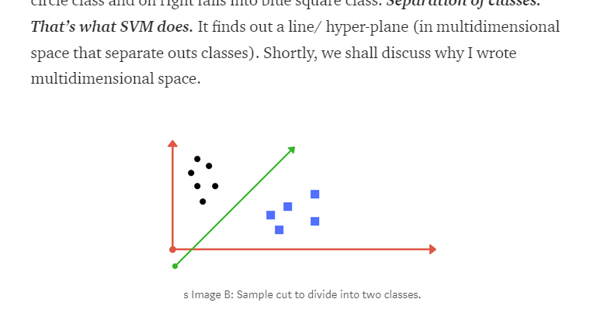

Slide 9
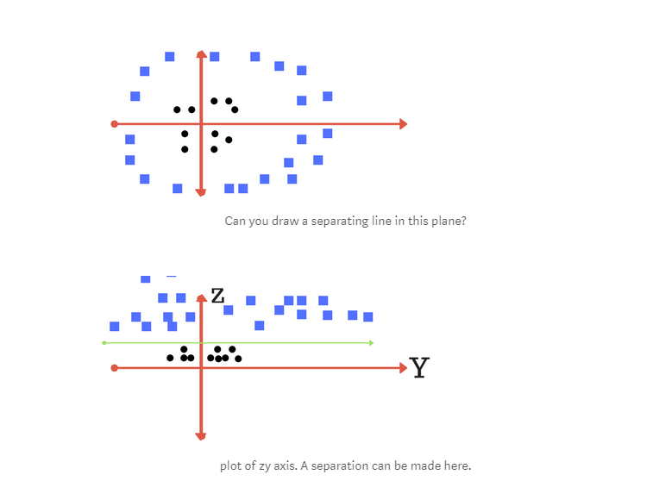

Slide 10
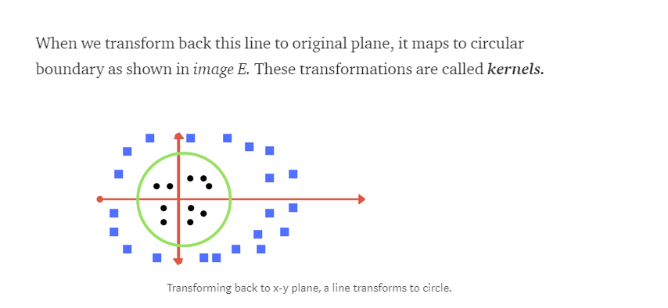

Slide 11
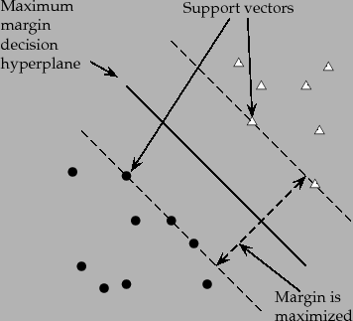

Slide 12
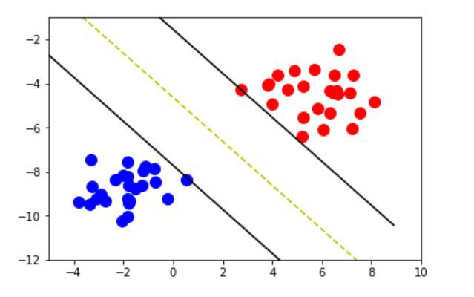

Slide 13
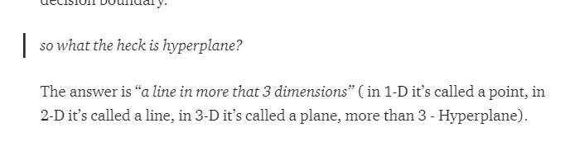

Slide 14
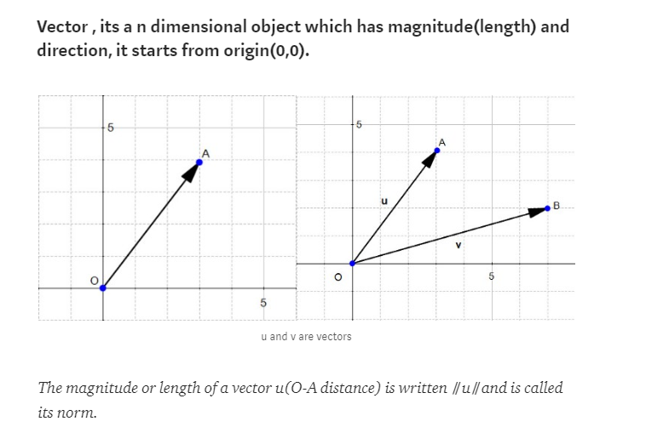

Slide 15
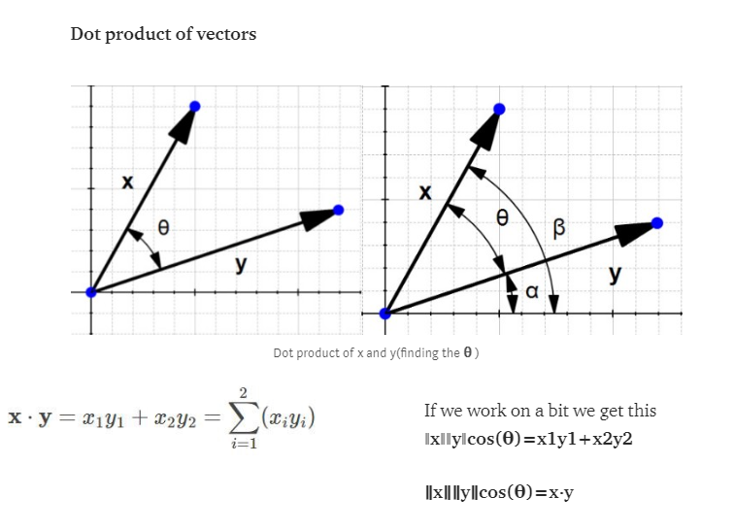

Slide 16
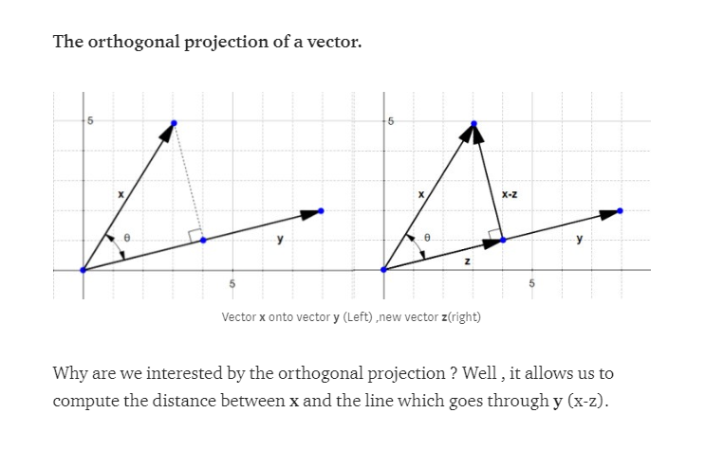

Slide 17
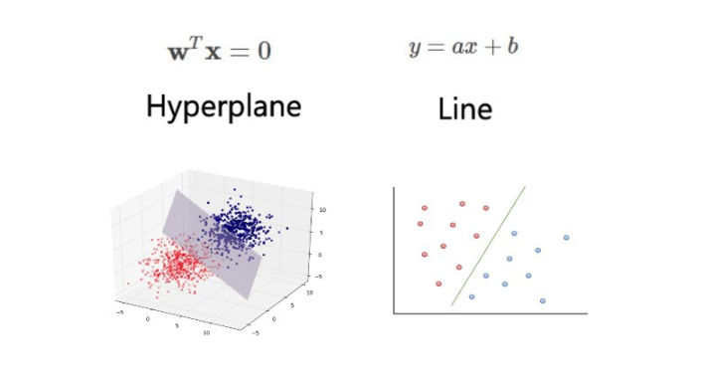

Slide 18
there is trade off.
regularization - gamma
These are tuning parameters in SVM classifier.

Slide 19
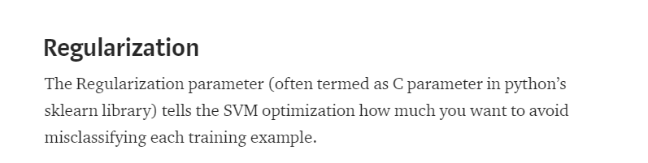

Slide 20
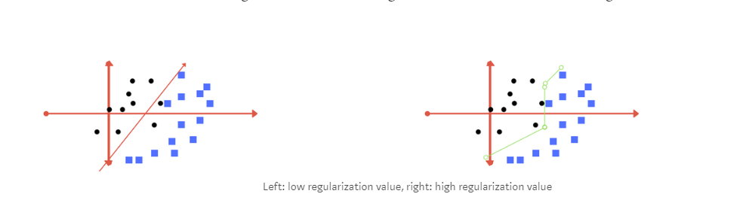

Slide 21
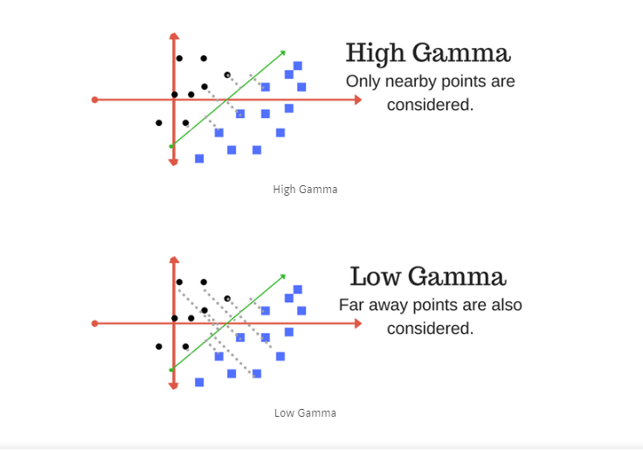

Slide 22
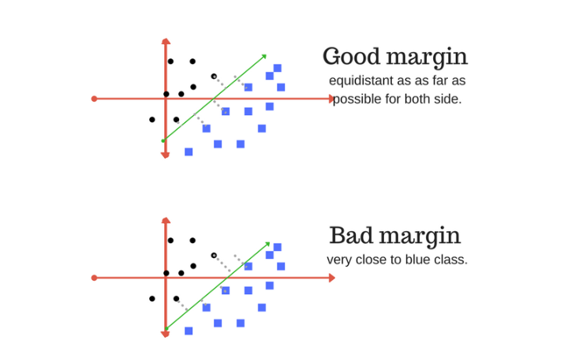

Slide 23
SVMs are helpful in text and hypertext categorization as their application can significantly reduce the need for labeled training instances in both the standard inductive and transductive settings.
Classification of images can also be performed using SVMs

Slide 24
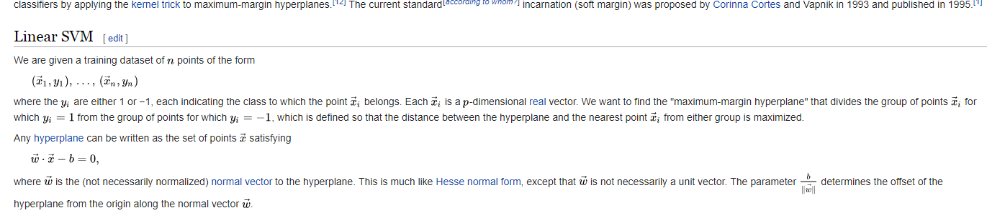

Slide 25
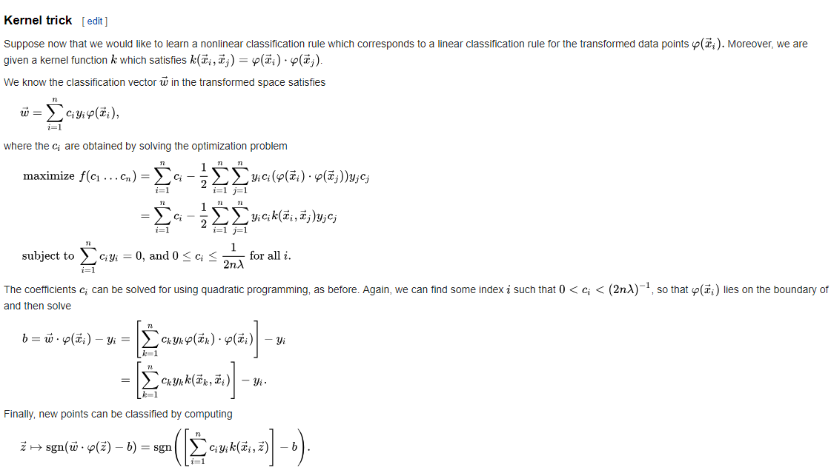

Slide 26
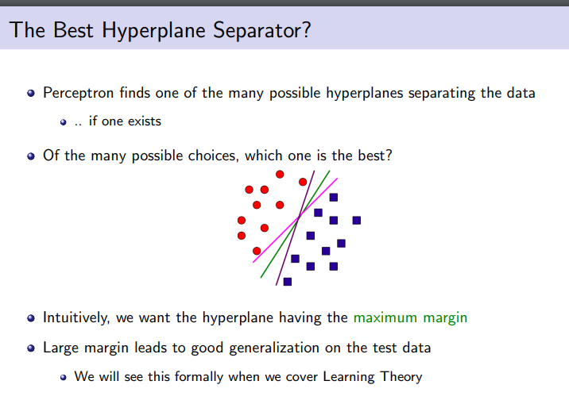

Slide 27
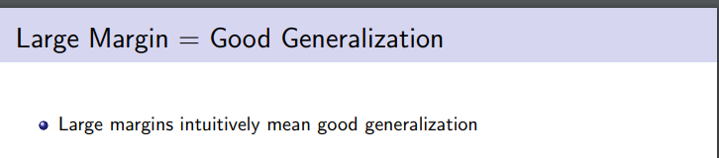

Slide 28
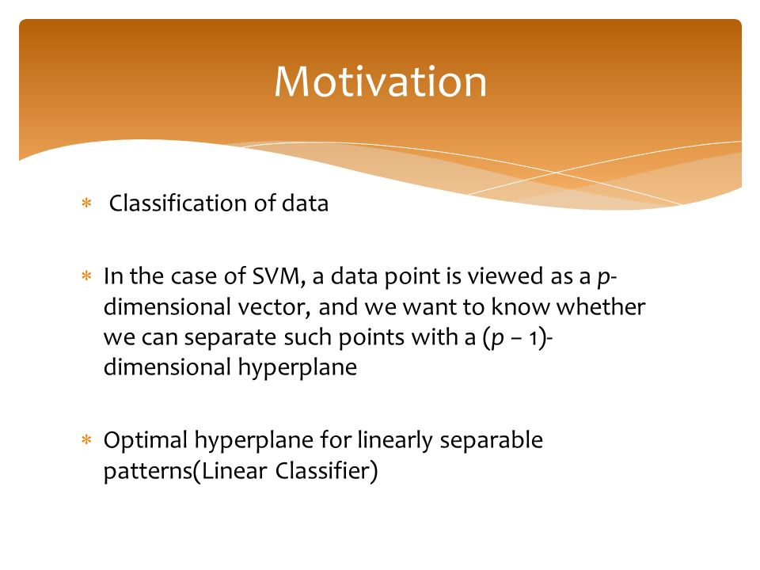
Motivation for Linear support Vectors

Slide 29
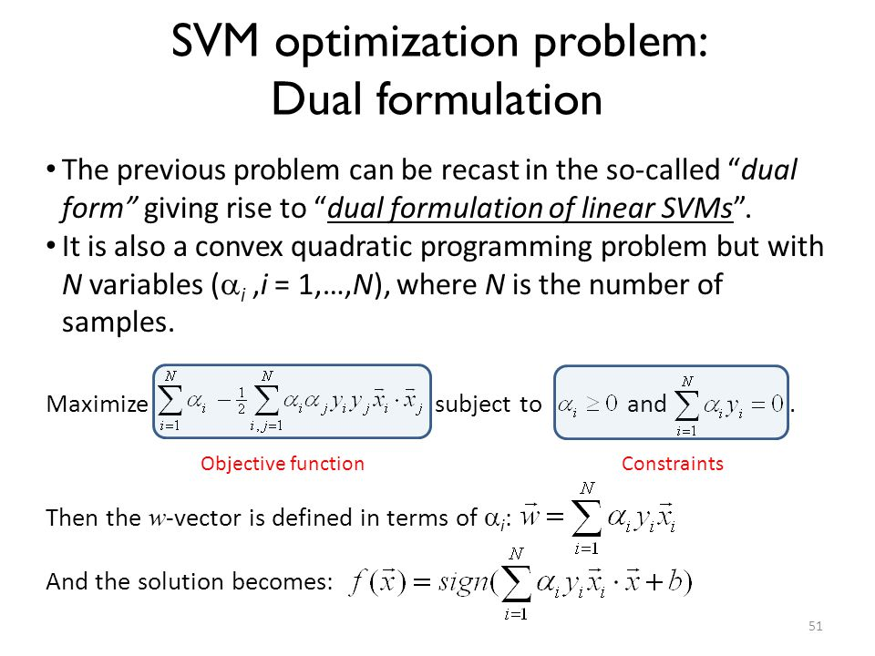

Slide 30
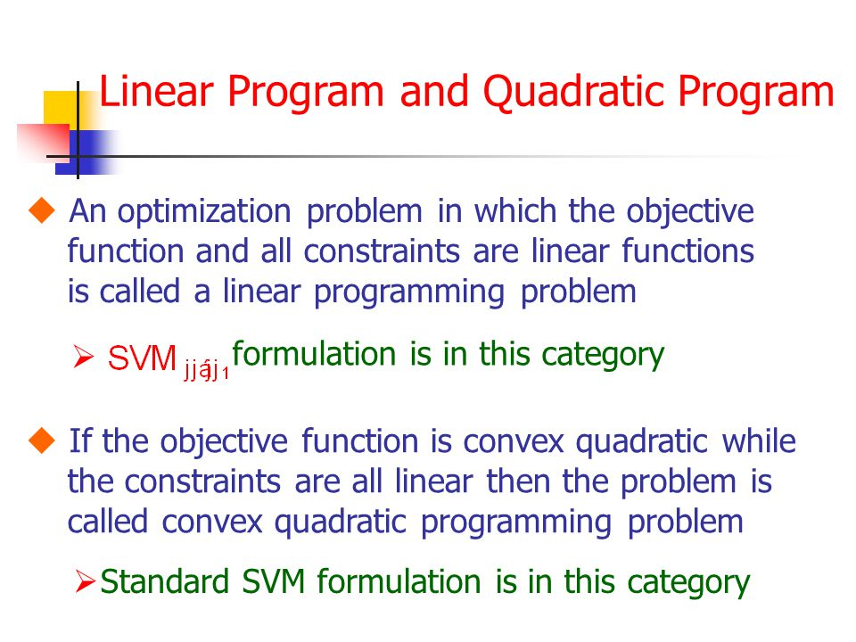

Slide 31
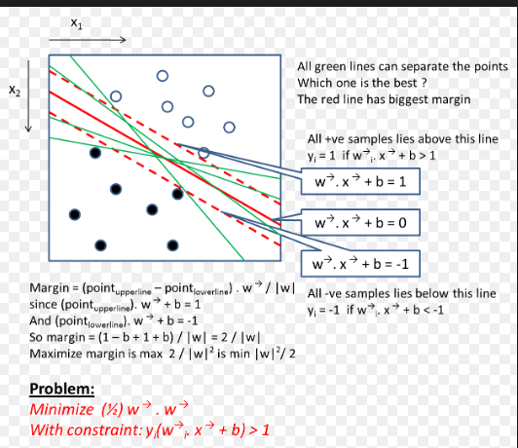

Slide 32
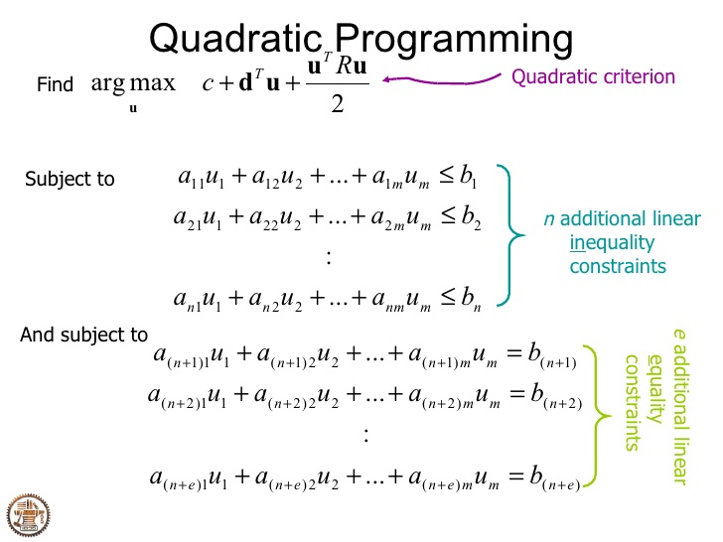

Slide 33
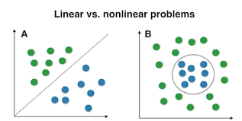

Slide 34
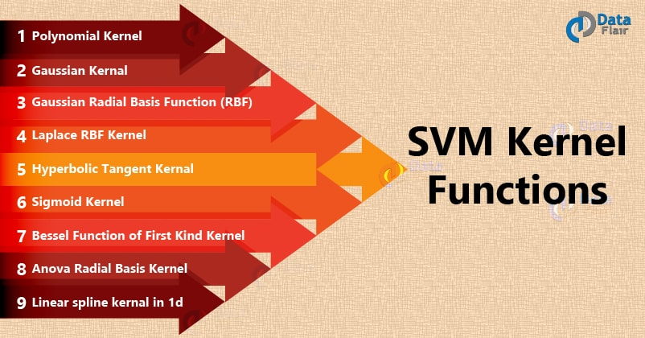

Slide 35
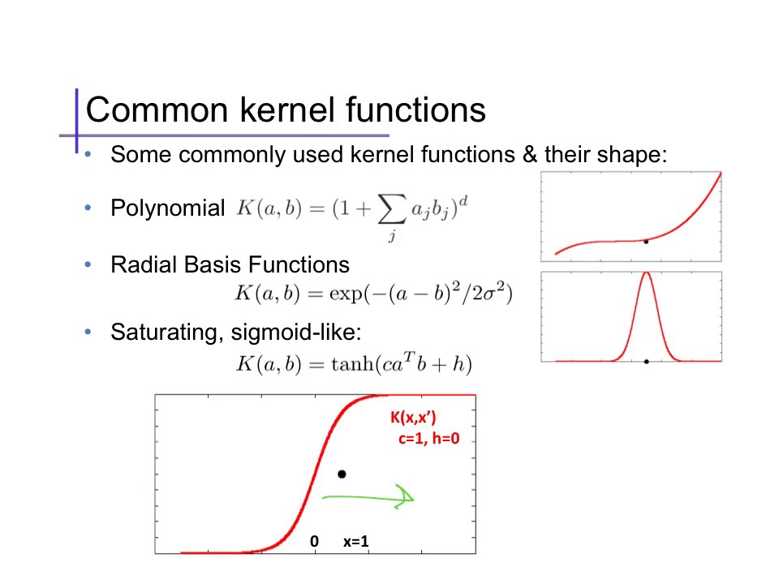

Slide 36
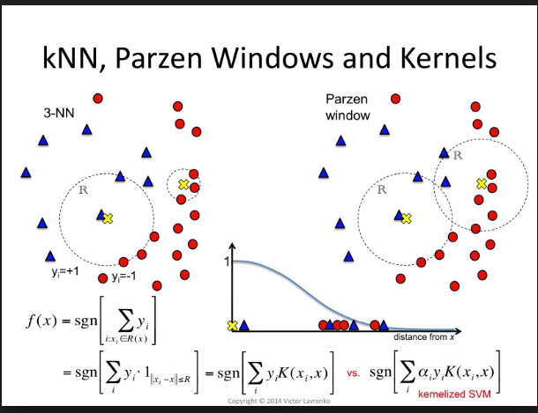

Slide 37
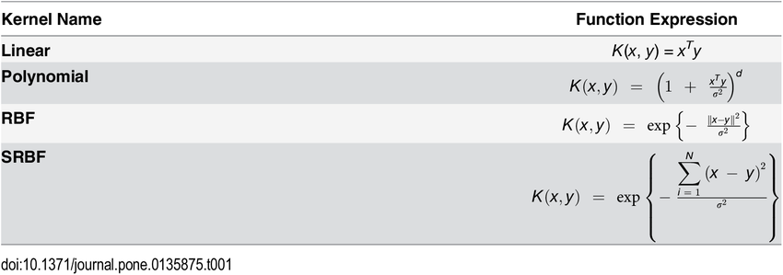

Slide 38
